Slide 1
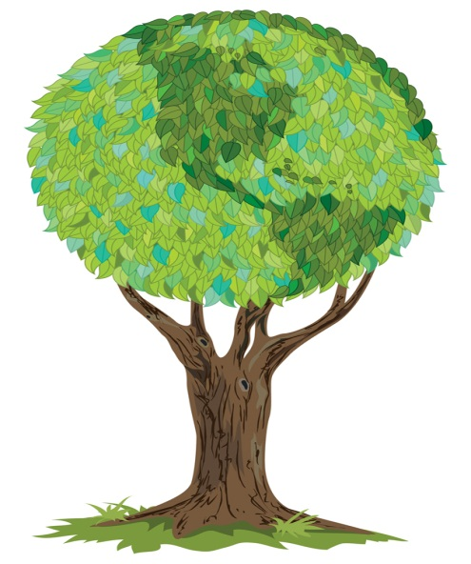
My Nature Journal
Created for use at
Laguna Atascosa National Wildlife Refuge
By: __________________________
My Nature Journal
Created for use at
Laguna Atascosa National Wildlife Refuge
By: __________________________

Slide 2
Leave it as you found it…
…means don’t touch it, don’t take it,
don’t eat it, don’t kill it, don’t bother it…
Please stay on trails and
clean up after yourself.
SHHHH! The quieter you are
the more you will see and hear.
A great way to capture memories of nature is to keep a nature journal. Use this journal to draw pictures, describe or tell stories of what you see. Find a quiet place, observe, listen and record. What did you see? What did it do? What did you hear? How does it smell? How does it make you feel?
Leave it as you found it…
…means don’t touch it, don’t take it,
don’t eat it, don’t kill it, don’t bother it…
Please stay on trails and
clean up after yourself.
SHHHH! The quieter you are
the more you will see and hear.
A great way to capture memories of nature is to keep a nature journal. Use this journal to draw pictures, describe or tell stories of what you see. Find a quiet place, observe, listen and record. What did you see? What did it do? What did you hear? How does it smell? How does it make you feel?

